Slide 1
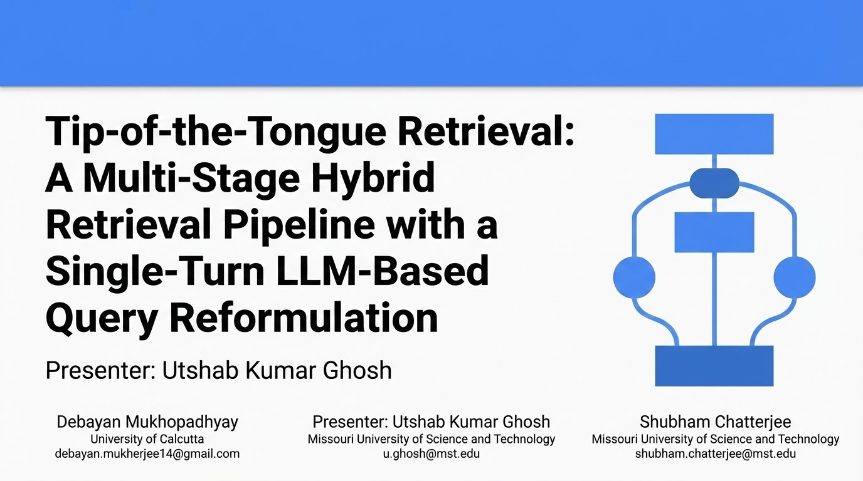


Slide 2
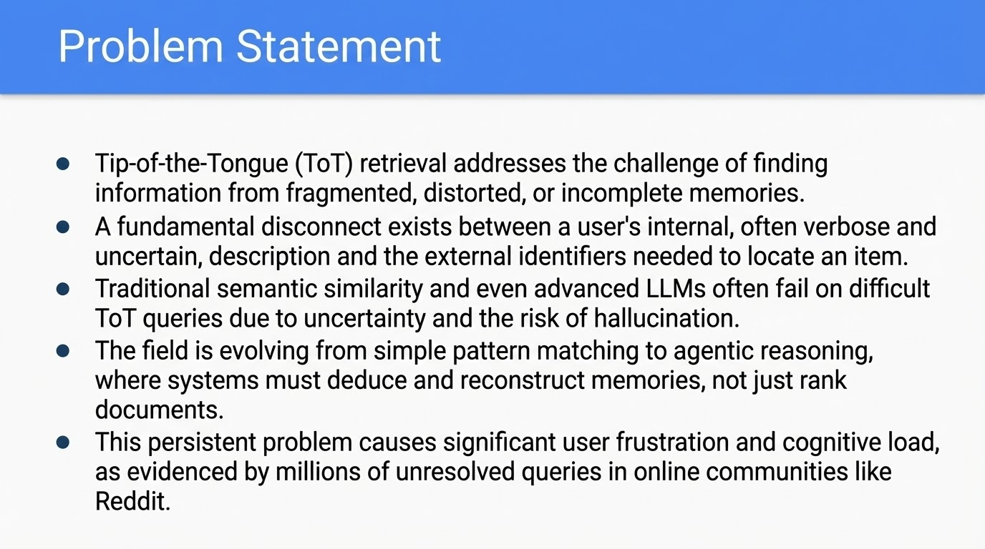
Tip-of-the-Tongue (ToT) retrieval addresses the challenge of finding information from fragmented, distorted, or incomplete memories.
A fundamental disconnect exists between a user's internal, often verbose and uncertain, description and the external identifiers needed to locate an item.
Traditional semantic similarity and even advanced LLMs often fail on difficult ToT queries due to uncertainty and the risk of hallucination.
The field is evolving from simple pattern matching to agentic reasoning, where systems must deduce and reconstruct memories, not just rank documents.
This persistent problem causes significant user frustration and cognitive load, as evidenced by millions of unresolved queries in online communities like Reddit.

Slide 3
Original Methodology and Analysis
As submitted for auto-evaluation on EvalBase before the TREC-TOT 2025 deadline on September 10, 2025 (AOE)

Slide 4
The Initial Hypothesis (Pipeline V1): Complexity & Fusion
Architecture: A complex, 5-stage hierarchical pipeline designed to maximize signal through aggressive fusion.
The Workflow:
Stage 1 (Sparse): Parallel retrieval using BM25, DPH, and TF-IDF on LLaMA-rewritten queries.
Stage 2 (Fusion): Reciprocal Rank Fusion (k=60) to merge the three sparse lists.
Stage 3 (Dense): 3-model ensemble (MiniLM, MPNet, Multi-QA) using weighted fusion (70% Semantic / 30% Sparse).
Stage 4 (LTR): LightGBM Learning-to-Rank model trained on a 6-dimensional feature vector (sparse + dense scores).
Stage 5 (Reranking): Late-interaction reranking (ColBERT-style) on the top 1000 candidates.
Our initial hypothesis was that 'more is better.' We built a heavy, 5-stage pipeline utilizing LightGBM, multiple dense retrievers, and complex Z-score normalization. We thought that by fusing every possible signal, BM25, DPH, MPNet etc. we could brute-force our way to high performance.
Notes:
We didn't start with the final architecture. We started with this: Pipeline V1. Our initial hypothesis was that 'more is better.' We built a heavy, 5-stage pipeline utilizing LightGBM, multiple dense retrievers, and complex Z-score normalization. We thought that by fusing every possible signal—BM25, DPH, MPNet—we could brute-force our way to high performance

Slide 5
V1 Results: The Complexity Trap
Evaluation: Tested on the same held-out test set as the final pipeline.
The Result: Despite the architectural complexity, the pipeline failed to capture relevant documents.
Recall@1000: 0.3204 (The "Recall Ceiling" was too low).
Success@10: 0.1009 (Only ~10% of queries found a relevant doc in the top 10).
nDCG@10: 0.0658 (Ranking quality was negligible).
Notes:
But the results were a reality check. Despite having five stages and a Learning-to-Rank model, the system failed. We achieved a Success@10 of only 10%—meaning 90% of the time, the user got nothing useful. The nDCG was near zero. This taught us a crucial lesson: complexity does not equal performance

Slide 6
Post-Mortem: Why Did V1 Fail?
Diagnosis 1: Signal Dilution
Aggressive fusion (RRF + Weighted + Z-Score) diluted the strong signals with weak ones.
Diagnosis 2: The Recall Bottleneck
Recall@1000 peaked at 0.32. The downstream rerankers (LightGBM/ColBERT) were starving for relevant candidates. You cannot rerank what you haven't retrieved.
The Pivot:
Shift from "Feature Engineering" (LTR) to "Intent Engineering" (Reformulation).
Simplify the pipeline to focus on High Recall First, then High Precision.
Result: This failure paved the way for the Reformulation-First Architecture (Pipeline V2).
Notes:
Why did it fail? Two reasons. First, 'Signal Dilution'—by averaging so many models, we drowned out the few that were actually working. Second, and most importantly, our Recall was only 0.32. We were losing the relevant documents before the rerankers even saw them. We realized we didn't need a better ranking algorithm (LightGBM); we needed better queries. This led us to pivot entirely to the Reformulation-First architecture we are presenting today.

Slide 7
Revised Methodology and Analysis
We started working on Pipeline V2, right after the submission deadline, using the dataset splits and QRELs already available on the Track’s website. We were able to validate our improved pipeline using the held out test set, when the track organizers, emailed us the test set QRELs along with the evaluation files of our original pipeline

Slide 8
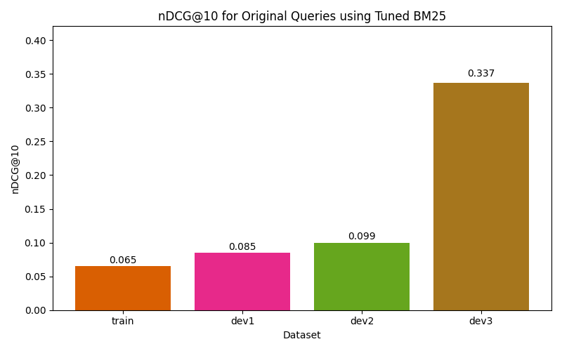
The Challenge: Tip-of-the-Tongue (ToT) Bottleneck
The Problem: The original queries are riddled with ToT artifacts, diluting the signal of key terms.
The Consequence: Sparse retrievers (e.g., BM25), even when well-tuned, fail to retrieve relevant documents due to this noise.
Notes:
We start by establishing the baseline. As you can see, even a robust BM25 implementation struggles here. The noise in Tip-of-the-Tongue queries drowns out the signal, leading to poor nDCG and Recall.
These charts proves that ranking isn't our problem yet, understanding is. If we don't fix the input with reformulation, the rest of the pipeline is just processing garbage.

Slide 9
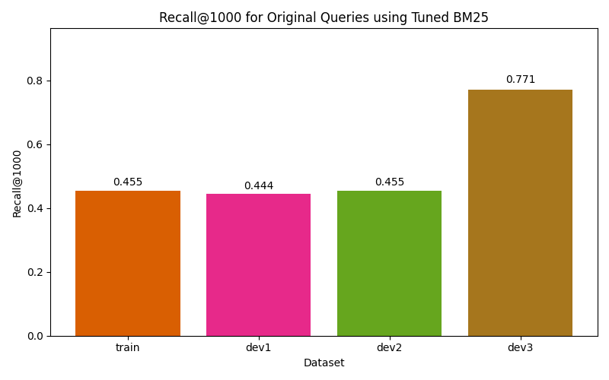
The Challenge: Tip-of-the-Tongue (ToT) Bottleneck (contd.)
The Root Cause: The primary bottleneck is Intent Understanding, not ranking.
Strategy: Without extracting stronger signals via Query Reformulation, the pipeline suffers from "Garbage In, Garbage Out" (GIGO).

Slide 10
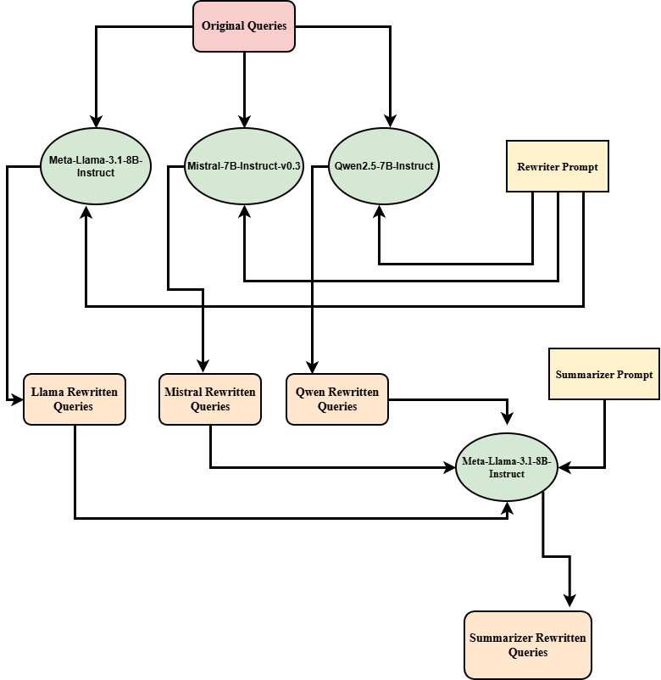
Query Reformulation Flow
Figure: Visualizing the transformation of raw ToT queries into structured search intents.
Notes:
This flowchart illustrates our proposed reformulation strategy. It outlines the step-by-step logic we use to disentangle the user's intent from the noisy description before passing it to the retrieval system

Slide 11
Re-writer Prompt Design
You are a query rewriter for a search engine. Your task is to rewrite a complex, verbose, tip-of-the-tongue description into a simple, keyword-focused search query.
Guidelines:
Identify the core entity type (e.g., movie, book, song) if implied.
Extract key details: plot points, character names, actors, famous scenes, or unique identifiers.
Remove conversational filler ("I think it was...", "It might be...", "I remember seeing...").
Remove negative constraints or uncertainty unless crucial ("Not sure if...").
Formulate a concise query that a standard search engine (like Google or BM25) would understand.
Output ONLY the rewritten query text. Do not output any explanations.
Figure: This prompt forces the models to act as strict filters, distilling the user's vague recollection into a structured search query

Slide 12
Query Consensus via Summarization Strategy
Hypothesis: While individual rewriters offer distinct perspectives, a consensus view provides the most robust query representation.
The Solution: Introduced a Summarizer stage using Meta-Llama-3.1-8B-Instruct.
The Mechanism:
Input: Receives the three rewritten query variations.
Process: Fuses them into a single, high-quality query.
Key Advantage:
Preserves Signal: Retains the most salient keywords identified across the ensemble.
Reduces Noise: Filters out hallucinations and idiosyncratic errors found in individual models.
Notes:
We didn't want to rely on just one reformulation. We hypothesized that combining perspectives might be stronger. So, we used Llama-3.1 to act as a 'judge' or 'summarizer.' It looks at the three variations, keeps the keywords that appear consistently, and discards the outliers or hallucinations, giving us one 'gold standard' reformulated query.

Slide 13
Summarizer Prompt Design
You are an expert search query optimizer. You will be given three different rewrites of the same original vague query. Your goal is to synthesize the BEST possible search query by combining the unique information from all three sources.
Instructions:
Analyze the three rewrites for common keywords and unique, high-value details (e.g., names, specific actions).
Create a single, consolidated query that captures the maximum amount of relevant information.
Keep it keyword-rich and concise.
Output ONLY the final summarized query.
Figure: Prompt instructions for synthesizing a consensus query by fusing rewriter outputs and filtering hallucinations

Slide 14
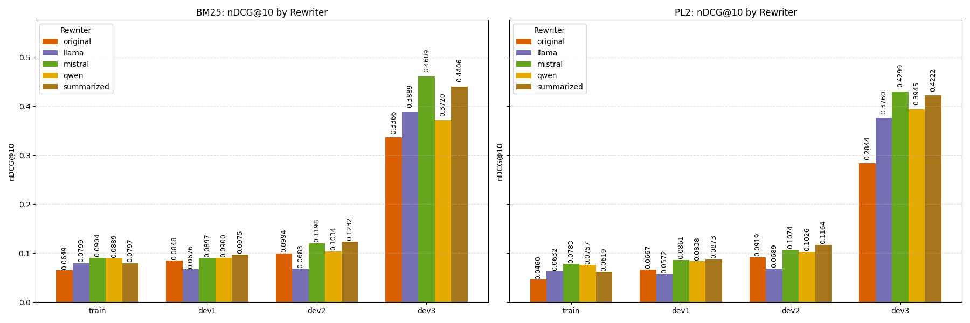
Reformulation Impact: Ranking Quality (nDCG@10)
Figure: Comparative analysis of nDCG@10 scores across dataset splits. The significant lift over the baseline confirms that reformulation effectively restores ranking signal in ToT queries.
Notes:
First, looking at nDCG@10, we see a massive jump in ranking quality immediately after reformulation. But perhaps more importantly for a multi-stage pipeline

Slide 15
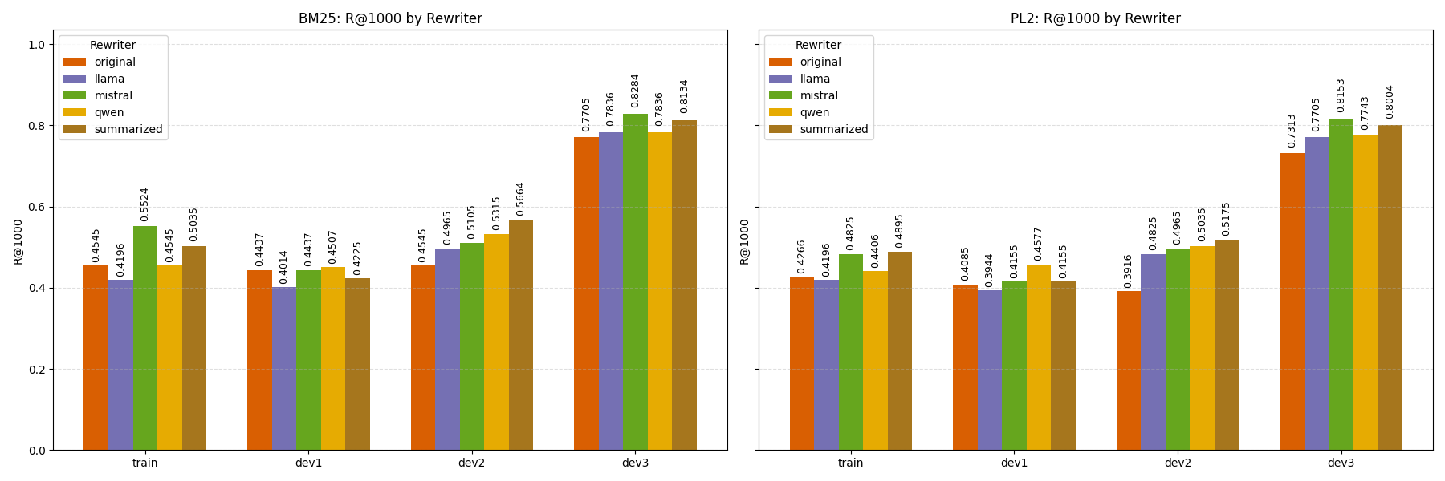
Reformulation Impact: Retrieval Coverage (Recall@1000)
Figure: Impact of reformulation on Recall@1000. High recall at this stage is critical to ensure the initial candidate pool contains the relevant documents for downstream re-ranking.
Notes:
Our Recall@1000 also spikes. This proves that without reformulation, we aren't just ranking poorly—we are completely missing the relevant documents. This step is non-negotiable

Slide 16
Optimal Strategy Selection: Performance vs. Cost
Performance Evaluation:
Tested across dataset splits using tuned BM25 and PL2 models.
Observation: Mistral rewritten queries consistently achieved the highest Recall@1000 and nDCG@10 scores.
Runner-up: The Summarized (Consensus) approach ranked second.
Strategic Decision:
We proceeded downstream using Mistral Rewritten Queries exclusively.
Rationale (Efficiency):
The Summarizer is computationally expensive, requiring 4 LLM prompts per query (3 rewriters + 1 summarizer).
Mistral offers superior metrics with significantly lower latency and compute cost.

Slide 17
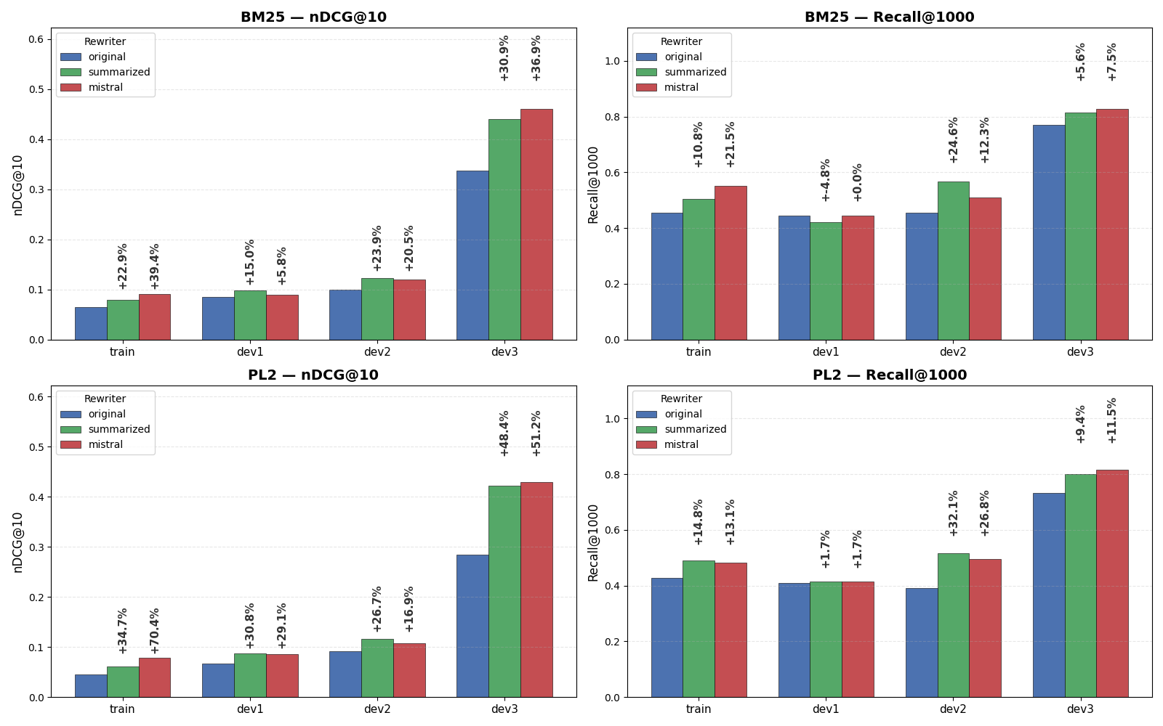
Optimal Strategy Selection: Performance vs. Cost
Figure:
Quantifying the "Reformulation Lift": Mistral-rewritten queries show massive gains over the original baseline across both sparse (BM25 and PL2) retrieval models.

Slide 18
Four Stage Retrieval Pipeline to Iteratively Refine Results
STAGE
01
Sparse Retrieval: "Cheap" and fast initial candidate generation from the full document corpus. Focusing on surface-level lexical matching to cast a wide net.
STAGE
02
Bi-encoder Ensemble: Semantic re-ranking of the initial pool to capture context and meaning that keyword matching missed. Addressing the "vocabulary mismatch" problem.
Candidate Set (K) is optimally pruned at every stage to reduce computational expense
STAGE
03
Cross-encoder Re-ranker: Evaluating the specific query-document pairs with high precision to filter out non-relevant documents before the final stage.
STAGE
04
List-wise LLM Re-ranker: Utilizing specific LLM capabilities to resolve final ambiguities and order the top results based on world knowledge and complex intent understanding.
Notes:
This slide visualizes the architectural flow. We start with 'Cheap Recall' using BM25 and PL2 to reduce the search space. We then move to Dense Bi-encoders to catch semantic nuances, refine that list with a Cross-Encoder for precision, and finally use an LLM for the 'last mile' optimization

Slide 19
Stage 1: Sparse Retrieval Baseline and Parameter Optimization Strategy
Objective: Establish a high-recall "safety net" to maximize candidate coverage.
Models:
Okapi BM25: Standard probabilistic baseline.
PL2 (Divergence from Randomness): Captures term distribution divergence.
Optimization Strategy: Sequential Adaptive Grid Search
Optimization Objective: Maximize nDCG@10 (Ranking Quality).
Flow: Employed a multi-stage tuning approach: train → dev1 → dev2 (We did not use dev3 for tuning parameters at any stage, as it served as our pseudo-test set).
Mechanism: Progressed from a coarse Global Search (Train) to a fine-grained Local Refinement (Dev sets) around optimal parameters to prevent overfitting.
(Full algorithmic details and search spaces available in our Notebook Paper Section 3.4.1)
Notes:
For our 'cheap recall' net, we used two probabilistic models: BM25 and PL2. Instead of a simple grid search on one dataset, we implemented a 'Sequential Adaptive' strategy. We tune on Train, carry those parameters to Dev1 to refine them, and then refine again on Dev2. This ensures our parameters are robust and not just overfitted to one specific set of queries.

Slide 20
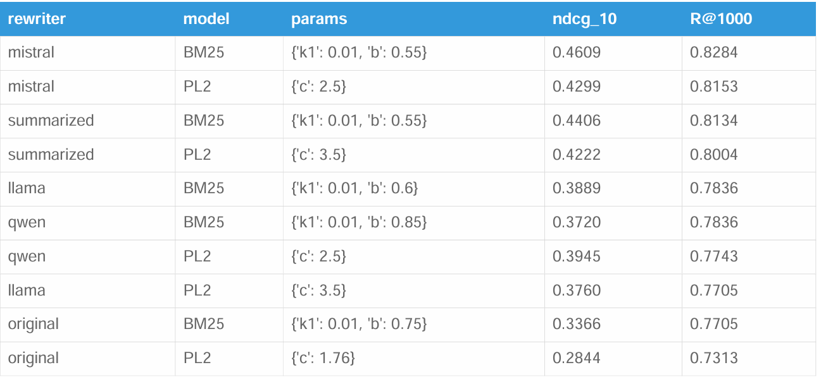
Stage 1: Sparse Retrieval Performance (BM25 vs. PL2)
Table: Mistral-rewritten queries outperform Original and Summarized queries on both retrieval models.
Notes:
Here are the results of our adaptive tuning. You can see that Mistral consistently provides the strongest signal. A key point to note: even though we optimized for nDCG@10, we found this effectively optimized Recall@1000 as well. By forcing the model to rank relevant documents at the top, we essentially forced it to maximize its understanding of the query, which naturally pulled more relevant documents into the candidate pool.

Slide 21
Stage 1: Sparse Retrieval Performance (BM25 vs. PL2) (contd.)
Metric: nDCG@10 (Proxy for Intent Alignment).
Optimized Parameters:
The Adaptive Grid Search converged on distinct "sweet spots" for each rewriter.
Observation: Mistral-rewritten queries consistently yielded the highest nDCG scores across both BM25 and PL2.
Correlation Note:
While we optimized for nDCG@10, we observed a near-perfect correlation with Recall@1000. Optimizing for top-tier ranking inherently ensured broad retrieval coverage.

Slide 22
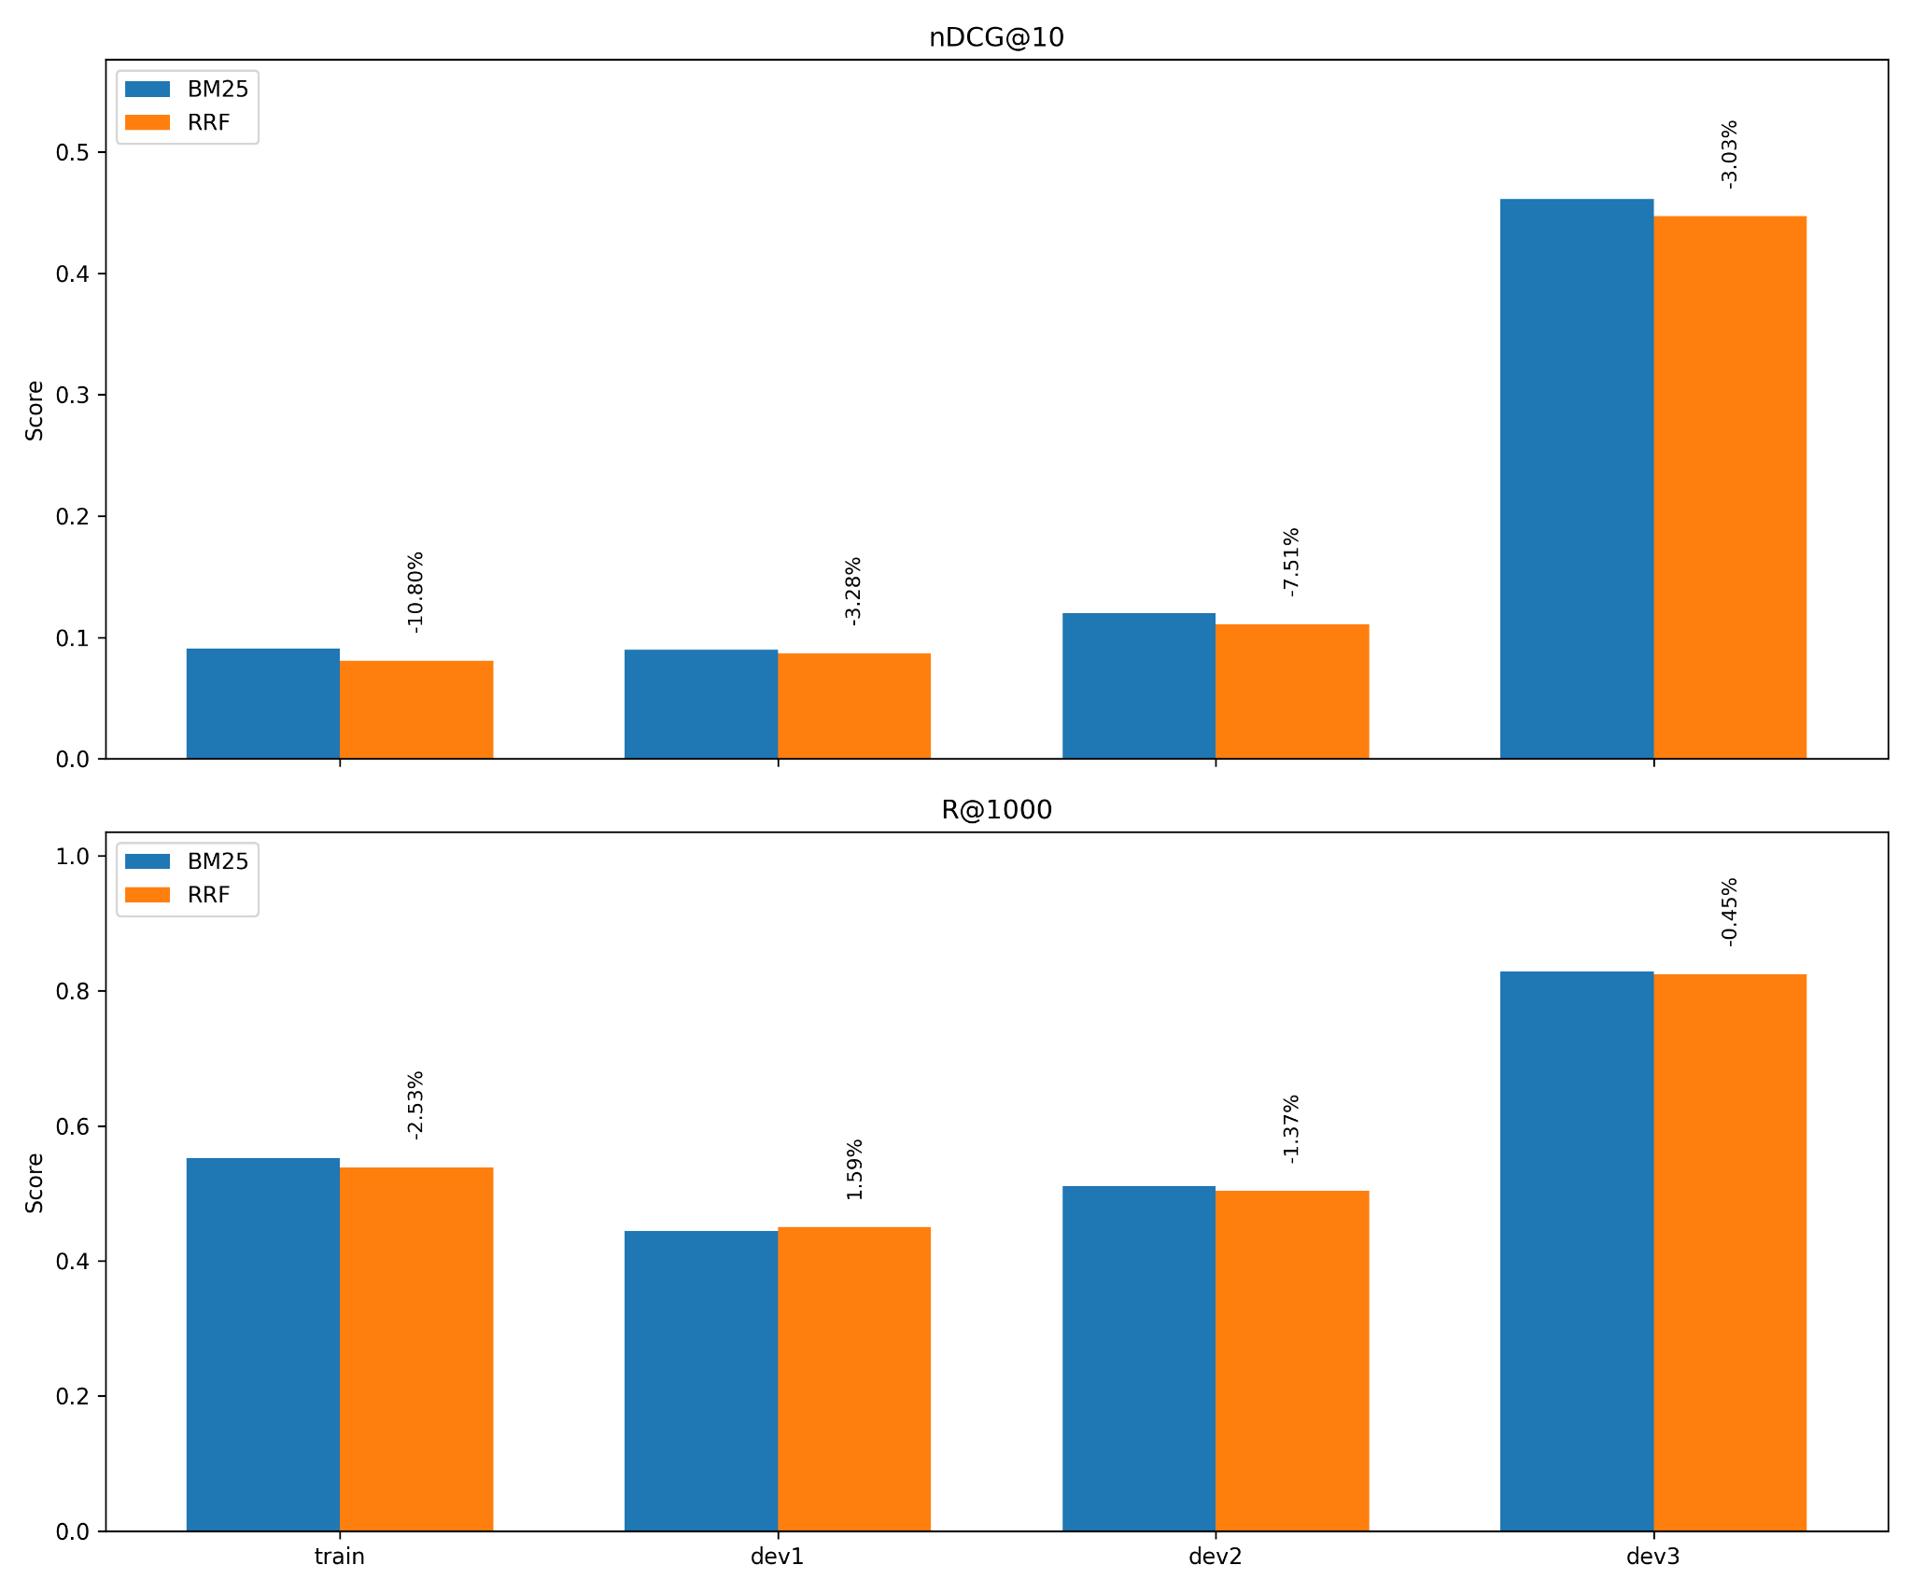
Stage 1: Why we dropped the idea of Sparse RRF?
Initial Hypothesis:
Combine BM25 and PL2 outputs using Reciprocal Rank Fusion (RRF) to maximize recall before the Dense Stage.
Empirical Finding:
RRF added computational overhead (running two retrievers + fusion logic) with negligible performance gain
Infact, the scores of the better performing BM25 was getting pulled down by the RRF as it was incorporating PL2’s ranked list
Decision:
Drop PL2 and RRF.
Proceed to the Dense Stage using only BM25 candidates derived from Mistral queries.
Benefit:
Reduces Stage 1 latency by 50% without compromising candidate quality.
Notes:
We initially planned to fuse BM25 and PL2 results using RRF to cast the widest possible net. However, the data showed that BM25 and PL2 were retrieving almost the exact same documents—the overlap was over 90%. Running both gave us virtually no recall gain but doubled our cost. So, we made the engineering decision to drop RRF and PL2, moving forward with just BM25. This cut our Stage 1 latency in half with zero penalty to performance

Slide 23
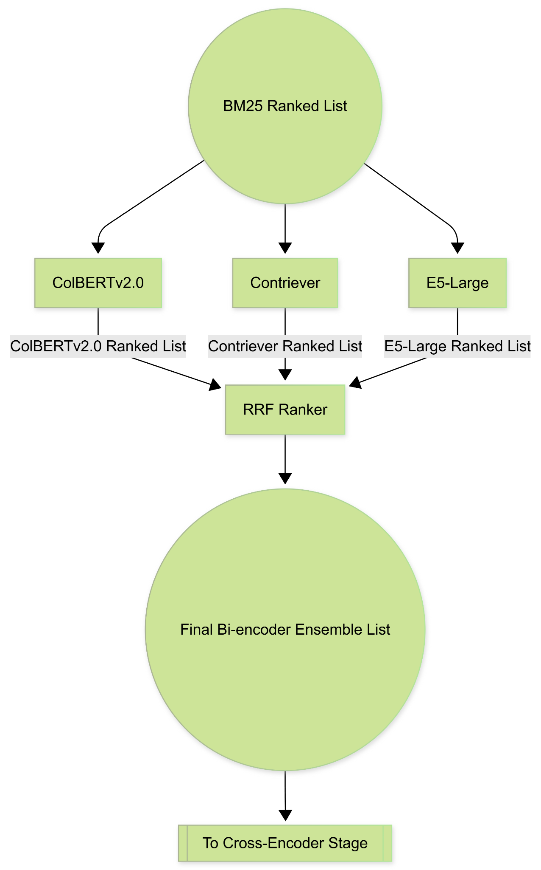
Stage 2: Bi-encoder Ensemble: Bridging the Semantic Gap
Objective: Address the "Vocabulary Mismatch" in ToT queries by capturing deep semantic signals (High-Recall Filter).
The Ensemble Approach: Implemented a parallel architecture of three distinct bi-encoders:
ColBERTv2.0: Late-interaction model; retains token-level granularity for verbose queries.
Contriever: Contrastive learning model; excellent zero-shot robustness.
E5-Large: Weakly supervised; provides strong semantic matching.
Fusion Mechanism:
Outputs combined via Reciprocal Rank Fusion (RRF) (k=60).
Result: A single, robust candidate list leveraging the strengths of all three architectures.
Notes:
Moving to Stage 2, we tackle the vocabulary mismatch. Sparse retrieval finds exact words, but Dense retrieval finds 'meanings'. We didn't rely on just one model. We built an ensemble: ColBERT for fine details, Contriever for zero-shot robustness, and E5 for general semantic matching. We run them in parallel and fuse the results using RRF. This gives us the best of all worlds.

Slide 24
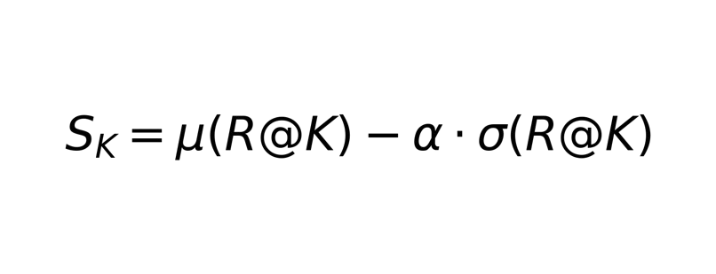
Stage 2: Optimization Strategy: Robust Candidate Depth (K_dense)
The Challenge: Determining the optimal number of documents (K_dense) to pass to the next stage.
Metric Shift:
Unlike Stage 1 (optimized for nDCG), Stage 2 is optimized purely for Recall.
Goal: Ensure the relevant document survives the filter.
Robust Aggregate Tuning:
Avoids overfitting to a single split by penalizing instability.
Formula:
Selects a depth that performs consistently across Train, Dev1, and Dev2.
Efficiency: Used "Virtual Tuning" (running inference once for Top-5k and slicing results) to rapidly test thousands of (K_dense) values.
Notes:
A critical design choice was deciding how many documents to keep. If we keep too few, we lose the answer. If we keep too many, we overwhelm the next stage. We used a 'Robust Aggregate' tuning strategy. We didn't just pick the depth with the highest average recall; we penalized depths that had high variance across our datasets. This ensures that the pipeline remains stable regardless of the data split.

Slide 25
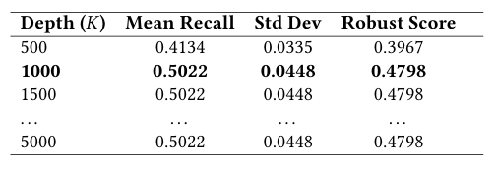
Stage 2: Performance Analysis: Ranking Degradation vs. Recall Stability
Observation:
Performance plateaued decisively across all three dense models.
Increasing candidate depth (K) from 1,000 to 5,000 yielded zero improvement in Robust Score or Mean Recall.
The "Recall Ceiling" Phenomenon:
The maximum recoverable recall is strictly determined by the top-1000 documents retrieved by the previous (Sparse) stage.
The Dense stage cannot "find" documents that the Sparse stage did not retrieve.
Decision:
Selected K = 1000 as the optimal cutoff.
Rationale: Fetching candidates beyond this point incurs computational cost with absolutely no potential gain in coverage.
Table: Results of Robust Candidate Depth Tuning for ColBERT.The performance plateaus at 𝐾=1000, indicating that deeper sparse retrieval yields no added relevant documents.
Notes:
When we tuned the depth, we found something interesting. Increasing the number of documents passed to the dense stage from 1,000 to 5,000 gave us zero lift. This confirms a 'Recall Ceiling': the Dense stage can't invent recall; it is limited by what the Sparse stage found. Since the Sparse stage saturated at 1,000, we capped the Dense stage there too. Going deeper would just be burning compute for free.

Slide 26
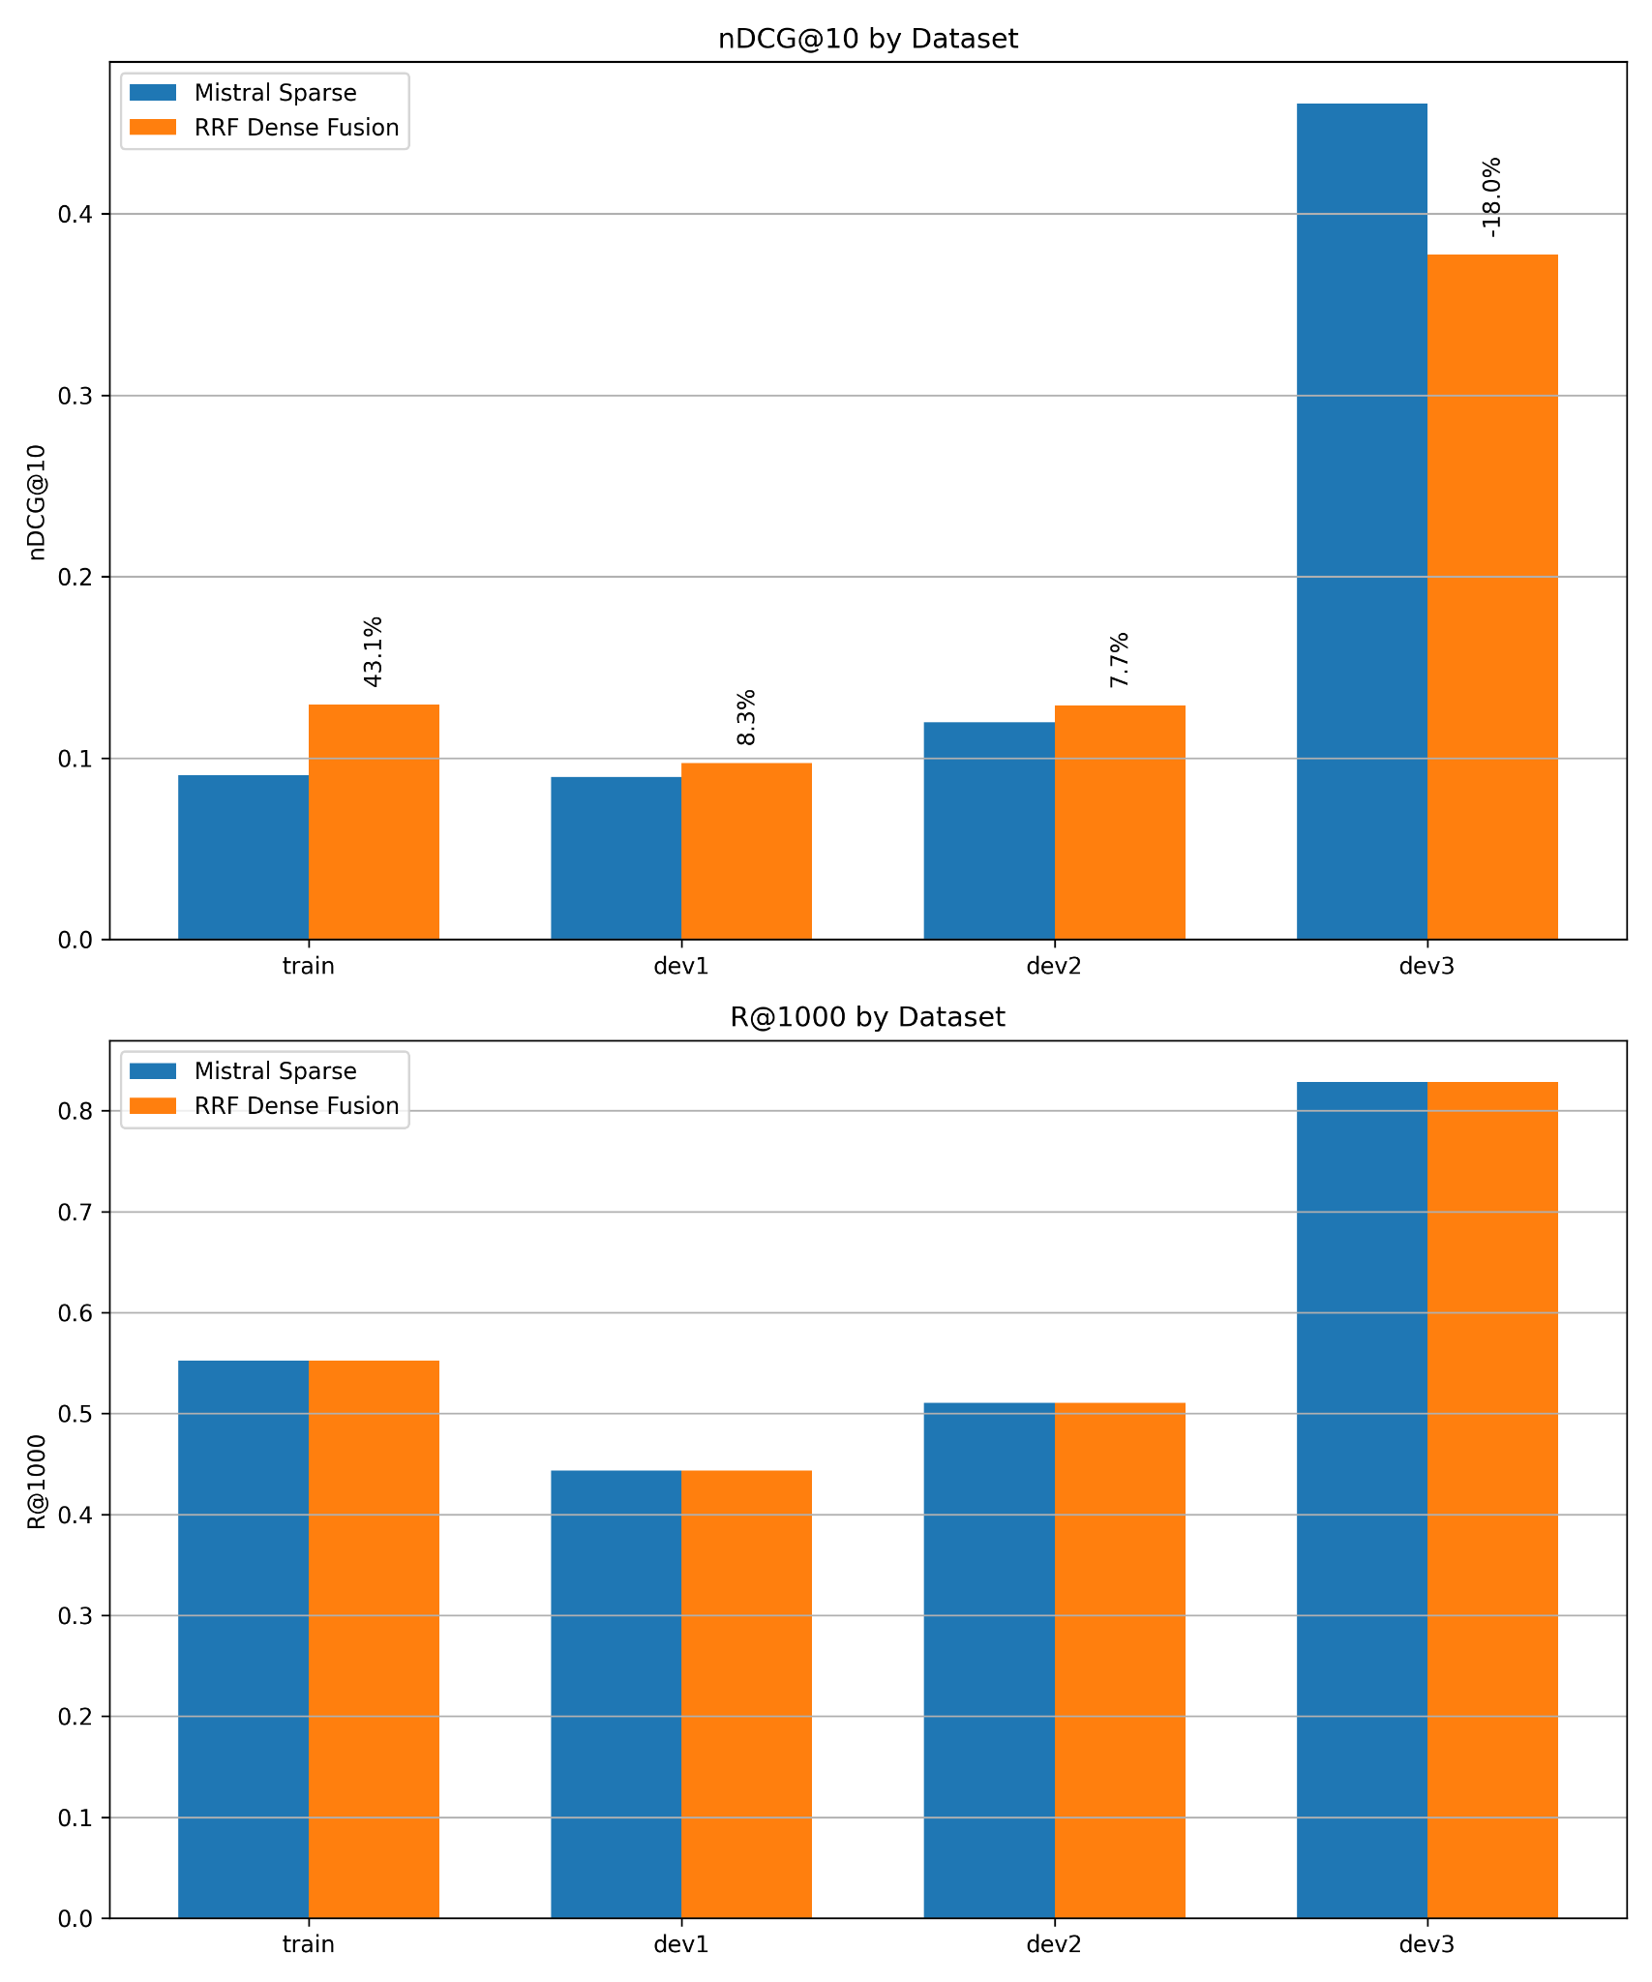
Stage 2: Performance Analysis: Ranking Degradation vs. Recall Stability
The Phenomenon:
Comparison of Input (Mistral BM25) vs. Output (Dense Fusion) reveals a critical divergence.
1. Ranking Degradation (nDCG@10 ↓18%) on Pseudo-Test Set:
Cause: Mistral queries are "keyword-optimized" for BM25.
Dense models, trained on natural semantic matching, likely penalized this "keyword-stuffing," pushing exact matches down in favor of broader semantic matches.
2. Recall Stability (Recall@1000 Constant):
Recall remained identical at 0.8284.
Implication: No relevant documents were lost; they were merely displaced from the top 10 to lower positions (ranks 11–100).
Strategic Decision:
Proceed with Dense Fusion.
We rely on the subsequent Cross-Encoder stage to repair the ranking order. The priority here was preserving the candidate pool, which was achieved.
Notes:
Here is the trade-off. After the Dense stage, our ranking score (nDCG) actually dropped by 18%. Why? Because the Dense models didn't like the keyword-heavy queries that Mistral wrote for BM25. However, look at the Recall—it stayed exactly the same. We didn't lose the documents; they just got shuffled down. We decided to accept this drop because we know the next stage, the Cross-Encoder, is a precision expert designed to fix exactly this kind of ranking error.

Slide 27
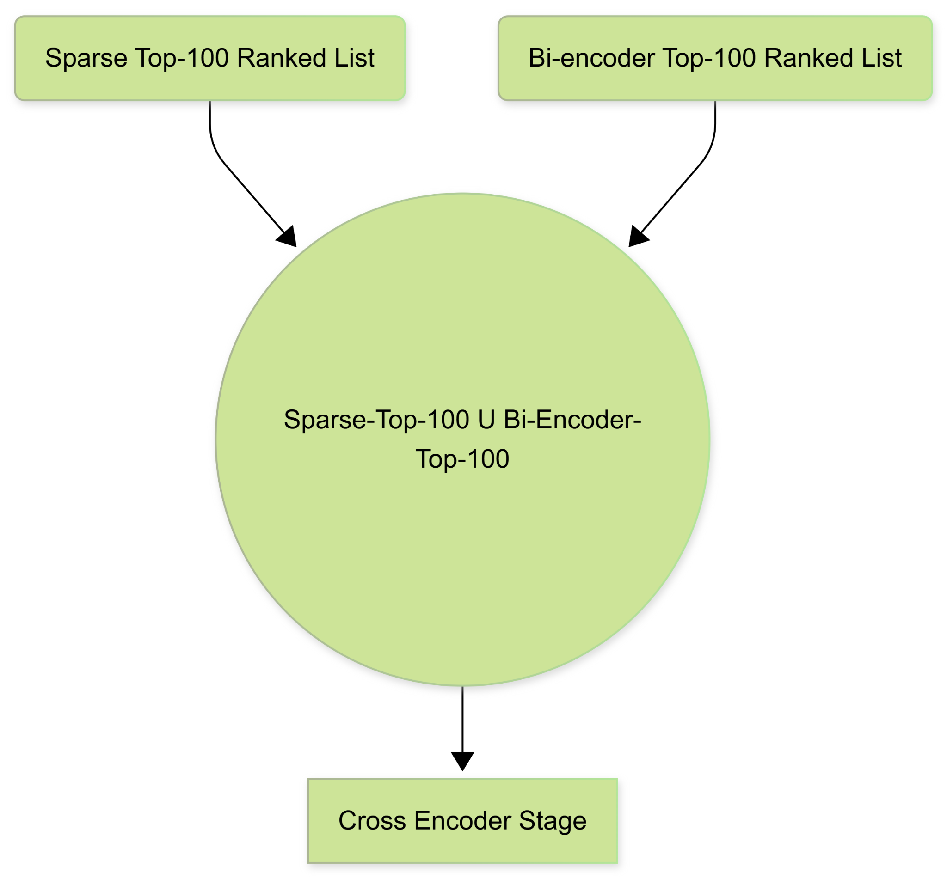
Stage 3: Cross Encoder Re-Ranker
The Problem: Dense retrieval introduced "Semantic Drift"—prioritizing broad topics over specific keyword constraints.
The Solution: Deployed monoT5-large as a Cross-Encoder to perform fine-grained relevance assessment (processing query and document simultaneously).
Methodology: Hybrid Input Pooling
To maximize coverage, we didn't just re-rank the Dense output.
The Union Pool: Constructed a candidate list by merging:
Top-100 from Sparse BM25 (Exact Match Signal)
Top-100 from Dense RRF (Semantic Signal)
Result: Ensures the Cross-Encoder has access to both precise keyword matches and broad semantic candidates.
Notes:
In Stage 3, we bring out the heavy guns. To fix the ranking errors from the previous stage, we used monoT5. But the smart part was how we fed it data. We used a 'Hybrid Input' strategy. We took the top 100 results from our keyword search (BM25) and the top 100 from our semantic search (Dense), and merged them. This guarantees that monoT5 sees the best of both worlds before it starts re-ranking.

Slide 28
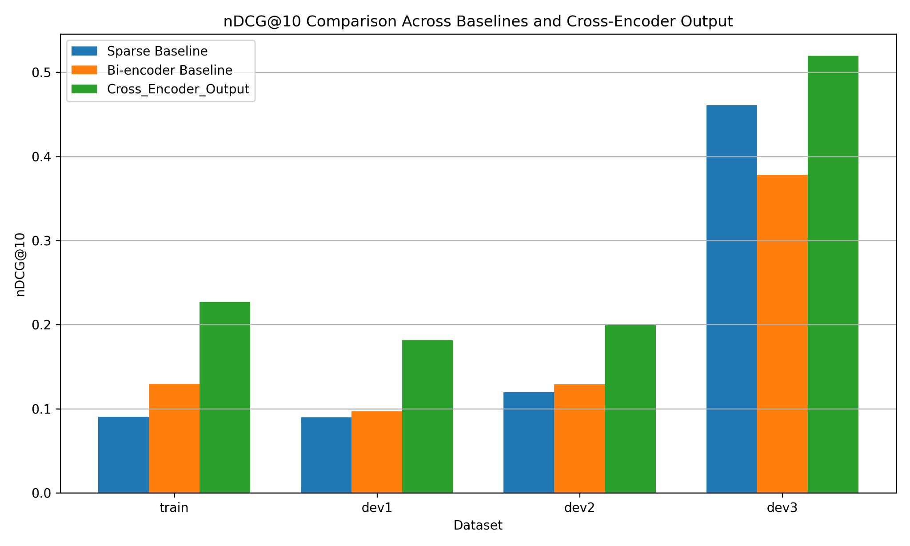
Stage 3: Performance Analysis of the Cross Encoder Re-Ranker
"Phoenix-like" Recovery:
The Cross-Encoder repaired the 18% performance drop incurred during the Dense stage and significantly outperformed the initial Sparse baseline.
Key Metrics:
Success@10: Boosted from 0.54 → 0.65.
Mechanism: Successfully identified relevant documents buried deep in the list (ranks 11+) and elevated them to the top.
The Trade-off:
Total Recall dropped from 0.828 → 0.733.
Analysis: We sacrificed "long-tail recall" (documents ranked >300) to secure massive improvements in top-tier precision.
Notes:
We call this the 'Phoenix' moment of the pipeline. As you can see the Cross-Encoder didn't just fix the damage from the previous stage; it pushed us to new heights. Our Success@10 jumped significantly. We did lose some total recall at the very bottom of the list, but that's a trade we willingly made. We sacrificed irrelevant documents at rank 300 to ensure the documents at rank 1 are perfect

Slide 29
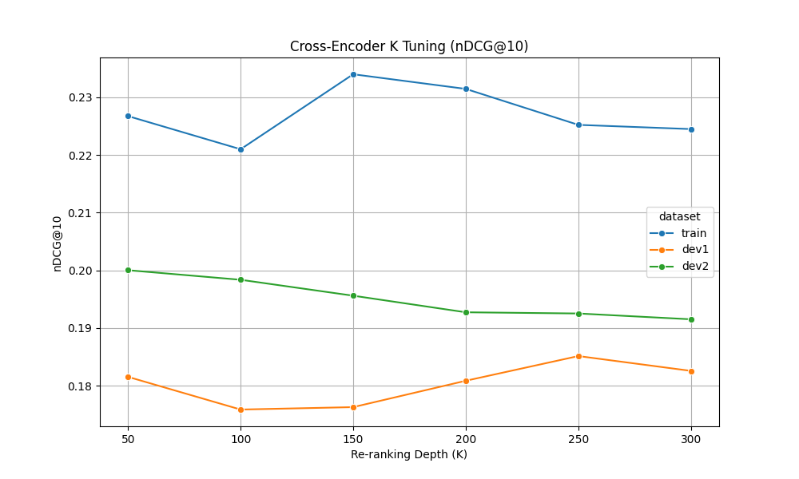
Stage 3: Optimizing Re-ranking Depth for Latency
Constraint: Cross-Encoders are computationally expensive; minimizing the candidate depth (K) is crucial for latency.
Tuning Observation:
Robust tuning sweeps revealed that the "relevance signal" is concentrated in the very top portion of the input list.
Re-ranking deeper candidates (Depth 100–300) introduced more noise than relevance, actually diluting the robust score.
Final Configuration:
Set K = 50
Impact: Maximizes ranking quality while ensuring maximum efficiency for the final LLM stage.
Notes:
Since Cross-Encoders are slow, we had to be efficient. We tested how deep we needed to re-rank. Surprisingly, going deeper than 50 candidates actually hurt performance, it just introduced noise. So, we set the cutoff at 50. This keeps the pipeline fast and ensures the final stage only receives the absolute highest-quality candidates.

Slide 30
Stage 4: List-wise LLM Re-Ranker
Model: Qwen2.5-72B-Instruct (4-bit quantized).
Strategy: Listwise Re-ranking.
Unlike point-wise scoring, the LLM evaluates a batch of candidates simultaneously.
Allows the model to compare candidates directly against each other to resolve subtle ambiguities.
Context Management:
Truncation: Documents truncated to the first 500 characters (approx. Wikipedia Introduction length).
Why Truncate?
"Lost in the Middle" Phenomenon: LLMs focus best on the start/end. Relevant ToT signals (plot summaries) are usually in the intro.
Cost/Latency: Full text (2k tokens) for 50 candidates would create 100k+ token inputs, exploding latency from seconds to minutes.
Notes:
For the final mile, we used Qwen2.5-72B. Instead of scoring documents one by one, we show the model the whole list and ask it to re-order them. We intentionally truncate documents to the first 500 characters. This isn't just to save money—it avoids the 'Lost in the Middle' problem. In Wikipedia articles, the key plot points matching a 'Tip-of-the-Tongue' query are almost always in the introduction. Feeding the full text just confuses the model with irrelevant details.

Slide 31
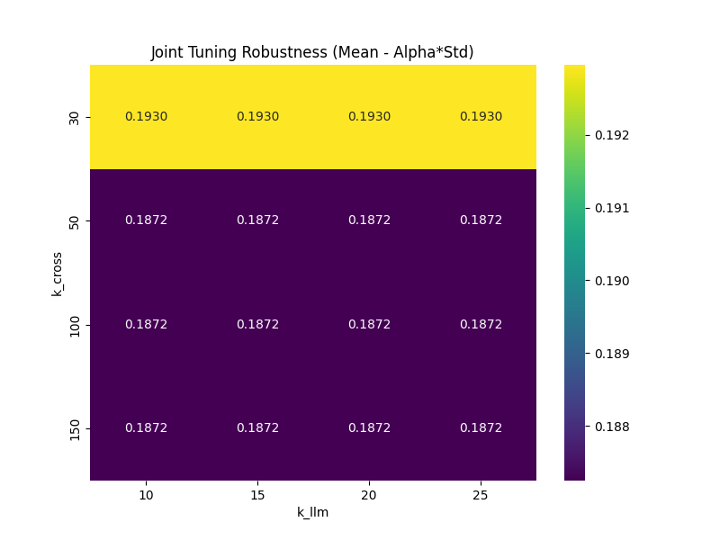
Stage 4: Optimizing Efficiency: Joint Parameter Tuning
Objective: Balance maximum precision with computational cost.
Method: Joint Grid Search optimizing two variables:
K_cross: Input window size passed from Cross-Encoder.
K_llm: Output depth of the re-ranked list.
Key Finding:
Performance saturates quickly. Smaller windows (K_cross=30) matched or outperformed larger ones (K_cross=50+).
Conclusion: Relevant signals are concentrated at the very top. Processing ranks 31–100 introduces noise, not signal.
Final Configuration:
K_cross = 30 (Input)
K_llm = 10 (Output)
Notes:
We ran a joint tuning sweep to see how many documents the LLM actually needs to see. The data showed that performance flatlines after just 30 documents. Sending more than 30 candidates didn't help, it actually hurt by introducing noise. So, we locked the input window to 30 and the output to 10. This creates a highly efficient final stage.

Slide 32
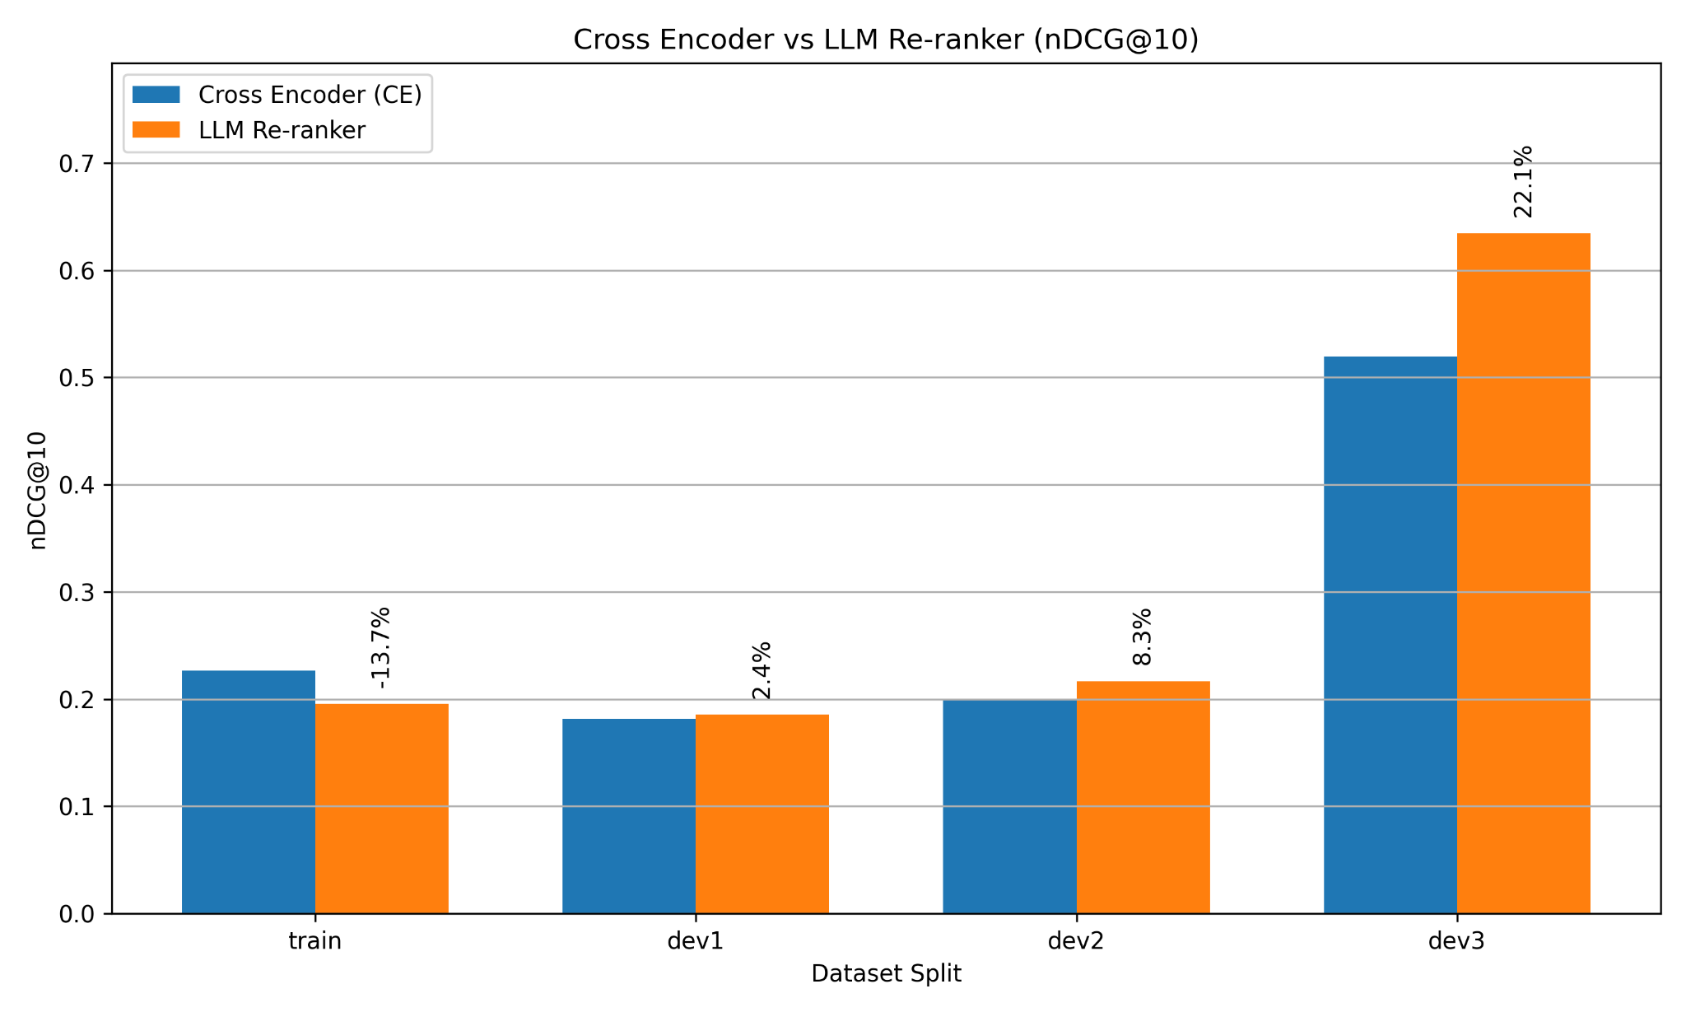
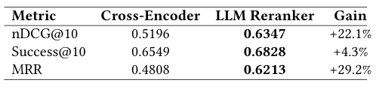
Stage 4: Final Results: Generalization vs. Overfitting
Blind Test Set (Dev3) Results:
nDCG@10: 0.6347
MRR Boost: +29.2% over Cross-Encoder.
Significance: The LLM excels at moving the ground truth to the precise Rank-1 position.
The "Regression" Anomaly:
Observation: While Test performance soared, Training set performance dropped (-13.7%).
Explanation:
Pipeline Overfitting: Previous stages (Sparse/Dense/Cross) were heavily tuned on the Train set, likely overfitting to specific patterns.
LLM Robustness: The LLM acts as a Zero-Shot Generalist. It ignores dataset-specific artifacts and re-ranks based on broad semantic reasoning.
Conclusion: The LLM corrects the overfitting, resulting in a slightly lower Train score but massive gains on unseen data.
Table: Performance comparison between the Cross Encoder(Input) and LLM Re-ranker(Output) on the pseudo-test set(dev3).
Notes:
Here is the most interesting finding. On our blind test set, performance skyrocketed—MRR went up nearly 30%. But on our training set, performance actually dropped. Why? Because the earlier stages were overfitted to the training data. The LLM, which has zero knowledge of our training set, ignored those overfitted patterns and ranked based on pure world knowledge. It acted as a 'correction layer,' sacrificing artificial training gains for genuine, real-world generalization.

Slide 33
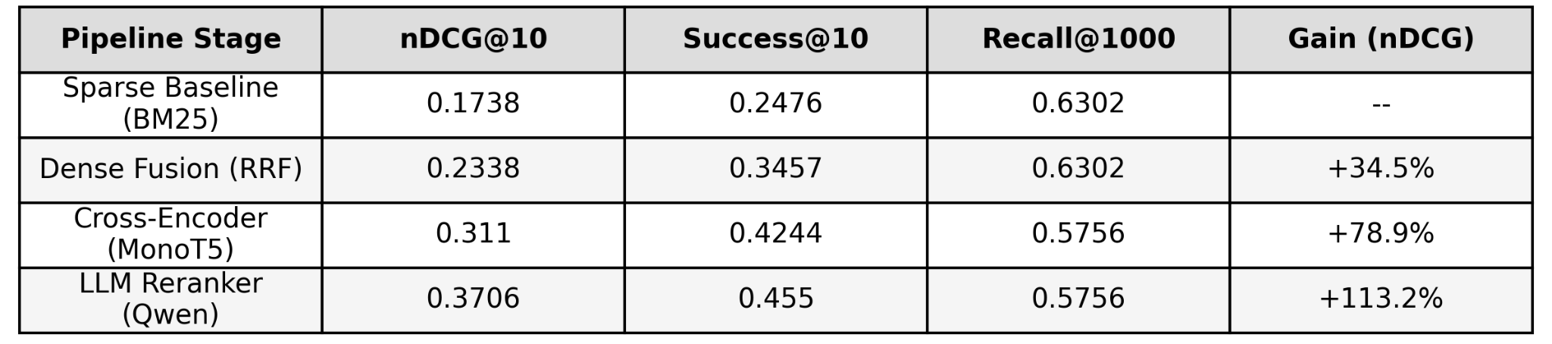
Final Pipeline Validation
Test Set Characteristics:
Evaluated on a strictly held-out test set.
Challenge Level: Significantly higher than development sets.
Features: Characterized by lower absolute recall baselines and high query ambiguity (hard ToT cases).
Performance Impact:
Achieved a +113.2% gain in nDCG@10 over the sparse baseline.
Success@10 nearly doubled (0.24 → 0.45).
Validation:
Results confirm that a single-stage retriever cannot handle ToT tasks. A cascaded approach is essential.
Notes:
We ran our final validation on a completely held-out test set. This was our hardest dataset yet—full of ambiguous, difficult queries. Despite the difficulty, the results were definitive. As you can see in the table, our final nDCG nearly doubled the baseline performance, achieving a 113% gain. This proves that for Tip-of-the-Tongue queries, a simple search engine isn't enough. You need the full cascade.

Slide 34
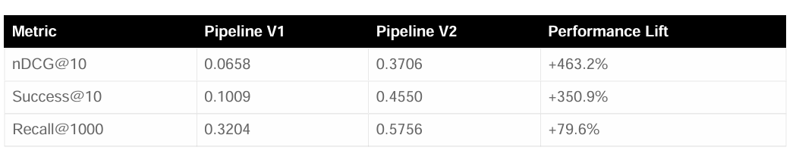
Impact of Architectural Evolution (V1 vs. V2)
The Paradigm Shift:
Pipeline V1 (Failed): Focused on Feature Engineering (Learning-to-Rank, aggressive fusion) → Failed due to low recall and signal dilution.
Pipeline V2 (Final): Focused on Intent Engineering (Reformulation) and Semantic Interaction (Cross-Encoder/LLM) → Succeeded by fixing the input and using deeper models.
Quantitative Lift:
Ranking Quality (nDCG@10): +463% improvement. The system went from "random guessing" to state-of-the-art ranking.
User Success (Success@10): +351% increase. The probability of a user finding their answer in the top 10 rose from 10% to 45%.
Conclusion:
Complexity is not enough. For ambiguous ToT queries, reformulation is non-negotiable.
Notes:
This final slide summarizes our entire journey. We started with Pipeline V1—a complex, feature-heavy system that failed, giving us only 10% success. We pivoted to Pipeline V2, prioritizing Reformulation and deep semantic interaction. The result is not just an incremental improvement; it is a transformation. We increased our ranking quality by over 400% and nearly quadrupled the success rate. This proves that in the Tip-of-the-Tongue domain, you cannot just engineer better features; you must engineer better intent

Slide 35
To Conclude:
Rewrite First Then Retrieve
Cascade From Recall to Precision
Deploy LLMs as Last Stage Semantic Reasoners
ToT query artifacts are the primary performance bottleneck.
LLM-based query rewriting is not an optional preprocessing step, it is the foundational requirement for turning a vague recollection into a machine-readable intent.
A multi-stage architecture is essential.
Use a high-recall foundation to cast a wide net, then apply computationally expensive, high-precision models like Cross-Encoders and LLMs to refine a much smaller, high-value candidate set.
The final precision gains come from large language models (72B+) acting as a listwise re-ranker.
Their extensive world knowledge allows them to resolve ambiguities that smaller, specialized models cannot.
Notes:
To conclude, this chart tells the whole story. We started with noise. Reformulation gave us signal. Sparse and Dense retrieval gave us coverage. The Cross-Encoder recovered our precision, and the LLM gave us the final push to State-of-the-Art performance. Thank you.

Slide 36
THANK YOU

